Slide 1
Advanced Computer Vision Final Project
Name：Yu Cho
Student ID：106318025
Instructor： Cheng-Ming Huang

Slide 2
Outline
Introduction
Method
Architecture
Morphology
Hough Transform
Draw Lines
Result
Conclusion

Slide 3
Introduction
I designed an algorithm to identify the specific lines in the image sequences
The mainly method is the Hough Transform
Initialize by mouse selection
At the end of the program
Save the tracking video
Evaluate the error
Evaluate the average execution time

Slide 4
Method
Architecture

Slide 5
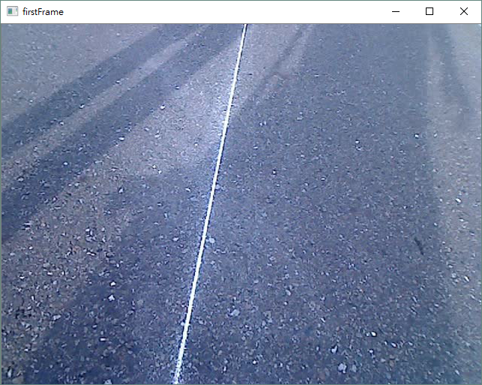
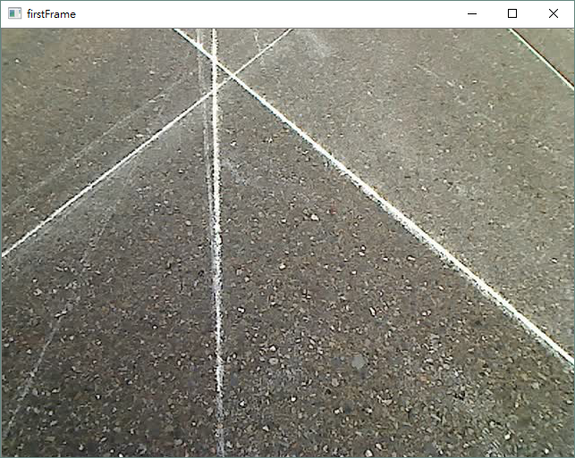
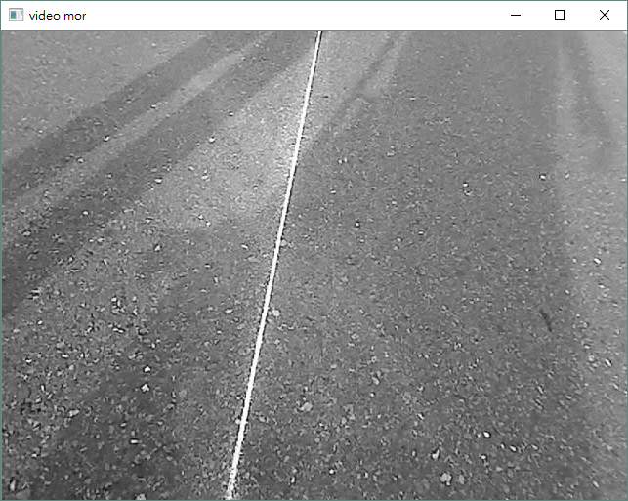
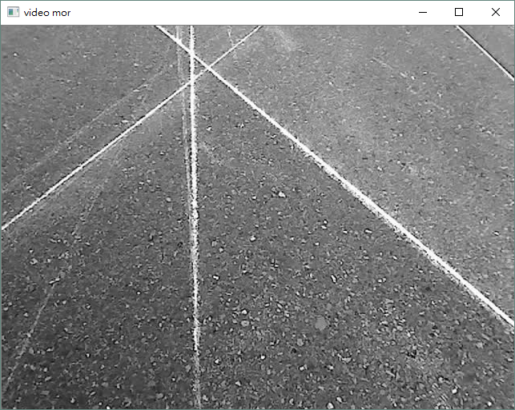
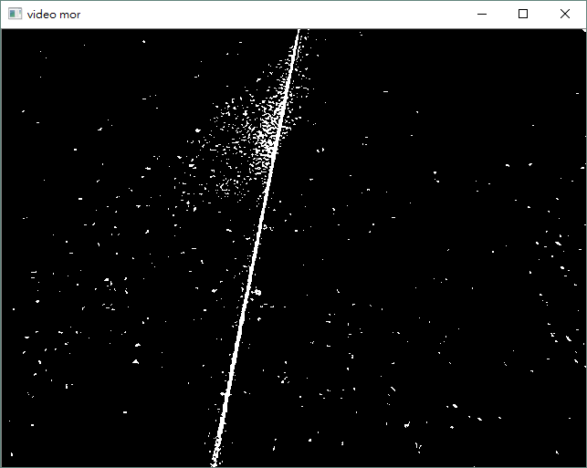
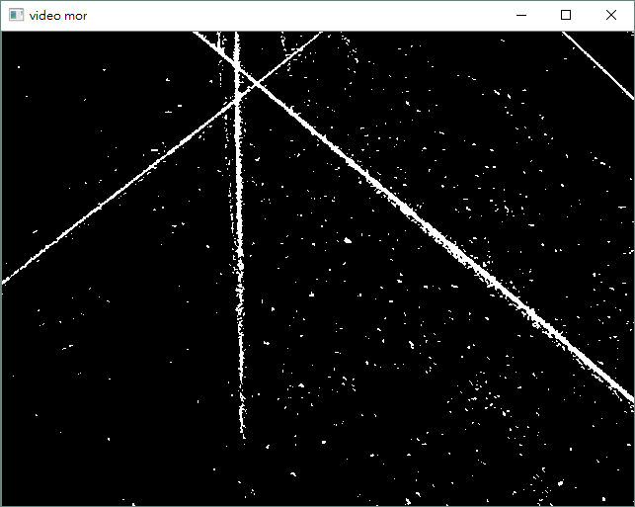
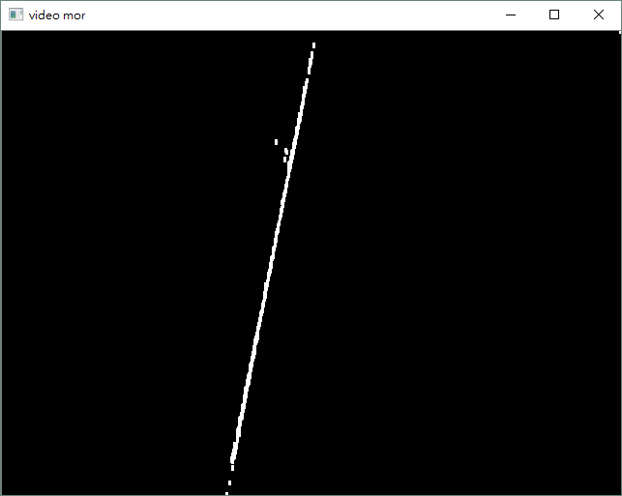
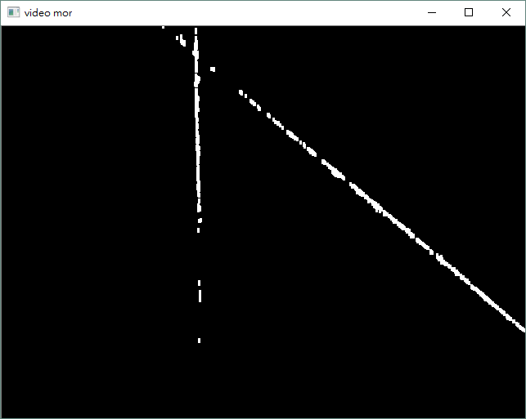
Method
Morphology
Step1.Grayscale
Step2.Binary
Step3.Opening

Slide 6
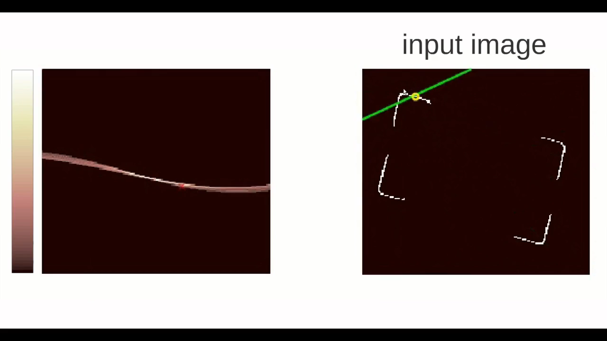
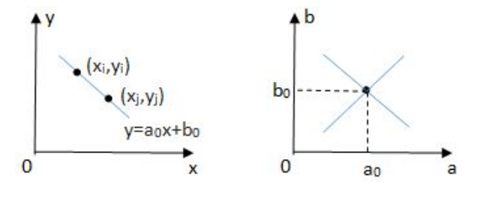
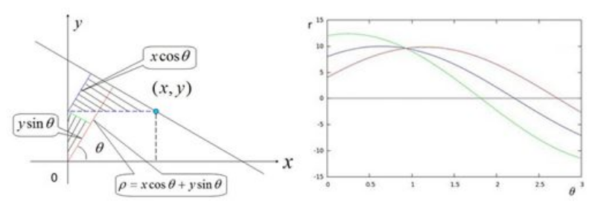
Method
Hough Transform

Slide 7
Method
Draw Lines

Slide 8
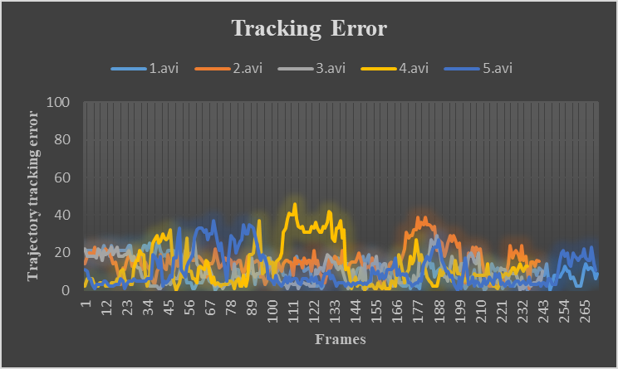
Result
Trajectory tracking error
Average Error
Average execution time
 | 1.avi | 2.avi | 3.avi | 4.avi | 5.avi
Average Error | 10.275 | 15.537 | 9.958 | 12.897 | 10.425
Average execution time(ms) | 14.135 | 14.605 | 14.967 | 16.953 | 18.295

Slide 9
Conclusion
Use mouse event to select the initial line
Detect specific line via the Hough transform
Update the points from last frame

